Slide 1
Medium Term Load Forecasting using Top Down Approach for Pakistan’s Power Sector
Supervisor: Dr. Naveed Arshad

Slide 2
Overview
What is Forecasting and why is Forecasting needed in energy sector of Pakistan?
Medium Term Load Forecasting
Exploratory Data Analysis
Parameter Selection
Model Building
Results
Future Work
Conclusion

Slide 3
Forecasting and its techniques
Process of making predictions based on the past or present data.
Qualitative Forecasting
Relies upon experts judgement
Often biased and comprised of personal judgements
Can be inaccurate
Quantitative Forecasting
Relies on numerical analysis
Consistent and objective
More accurate as compared to Qualitative Forecasting

Slide 4
Why forecasting needed?
Predicting demands of new and existing products
Anticipating customer’s need
Predicting cost of materials
Good usage of budget
Timely procurement and good planning

Slide 5
Energy Forecasting
Reasons for Energy Forecasting
Resource Allocation
Resource Ordering
Budget Planning
Types of Energy Forecasting:
Short Term Load Forecasting (1-2 days)
Medium Term Load Forecasting (1-2 years)
Long Term Load Forecasting (5-10 years)

Slide 6
Medium Term Load Forecasting
To forecast monthly energy demand and monthly peak power for the future span of one year.
Predictions on monthly granularity.
Factors affecting Forecasting:
Economic
Population and living styles
Geological
Weather etc

Slide 7
Data Availability:
NPCC Pakistan’s energy for 2019-2021
Weather attributes for nine major cities of Pakistan
Lahore
Multan
Faisalabad
Quetta
Peshawar
Gujranwala
Hyderabad
Sukkur
Islamabad.
Weather parameters include Temperature, Apparent Temperature, Dew Point, Humidity, Pressure, Wind Speed, Wind Gust

Slide 8
Exploratory Data Analysis

Slide 9
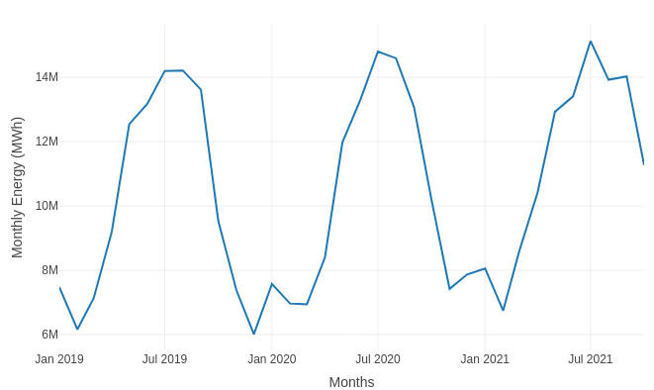
Monthly Energy (MWh)

Slide 10
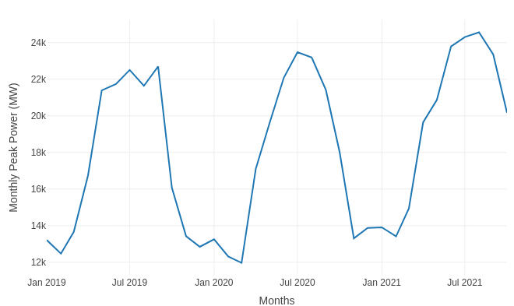
Monthly Peak Power (MW)

Slide 11
Parameters Selection
Independent Variables showing high correlation with Energy:
Apparent Temperature (0.88)
Temperature (0.83)
Pressure (-0.86)

Slide 12
Multicollinearity
The occurrence of high intercorrelations among two or more independent variables in a multiple regression model
Change in one independent variable results in change in some other independent variable.
Can lead to skewed or misleading results
Perfect collinearity exist if correlation between two independent variables is 1 or -1.
Apparent Temperature preferred to Temperature

Slide 13
Checked multicollinearity for three aggregated features with monthly:
Mean Lahore Apparent Temperature
Min Lahore Apparent Temperature
Max Lahore Apparent Temperature

Slide 14
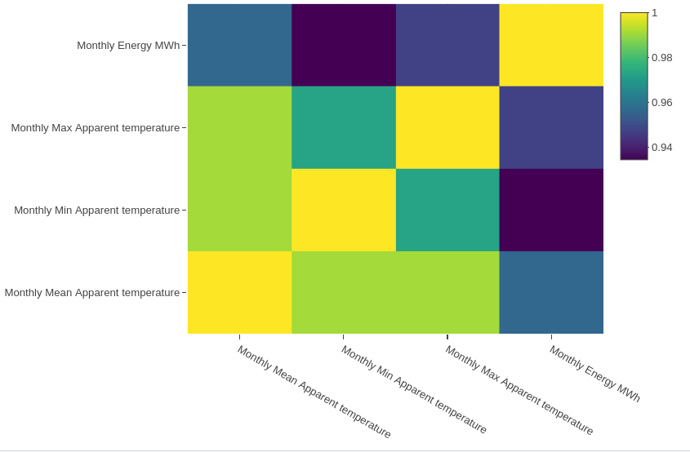
Heat Map for Multicollinearity

Slide 15
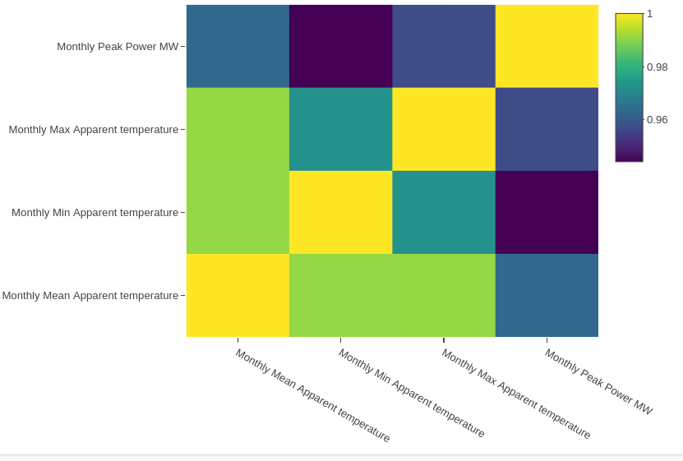

Slide 16
Model Building
Used Linear Regression for forecasting monthly energy load and monthly peak power.
Monthly Energy Model:
Input parameters: NPCC Monthly Mean Lahore Apparent Temperature
Output Parameters: Total Monthly Energy (MWh)
Peak Power Model:
Input parameters: NPCC Monthly Mean Lahore Apparent Temperature
Output Parameters: Monthly Peak Power (MW)

Slide 17
ARDL (Autoregressive Distributed Lag)
Mean Apparent Temperature for year 2021 is predicted using lag of previous 11 months.
Mean Apparent Temperature is used for building Monthly Energy Load and Peak Power Model.
Predictions for Monthly Energy Load and Peak Power are made for 2021 using Predicted Mean Apparent Temperature

Slide 18
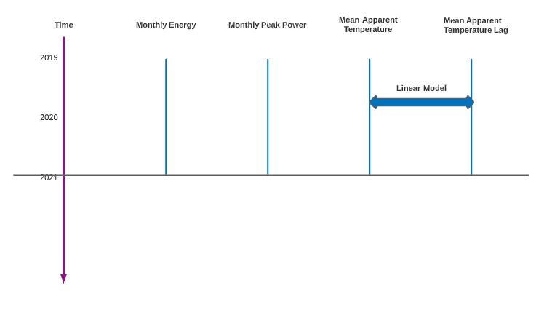
Model Building FlowChart

Slide 19
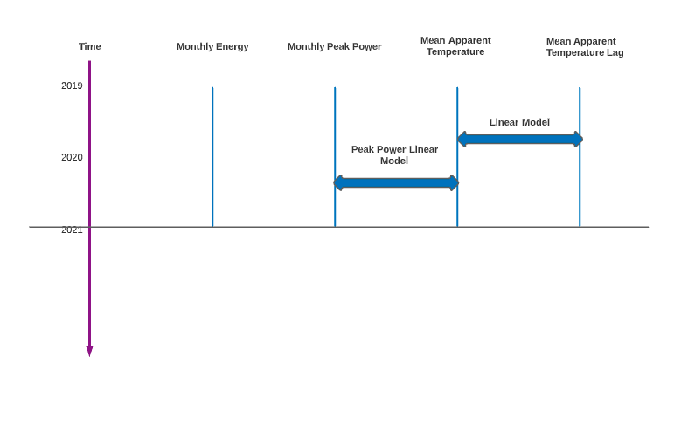

Slide 20
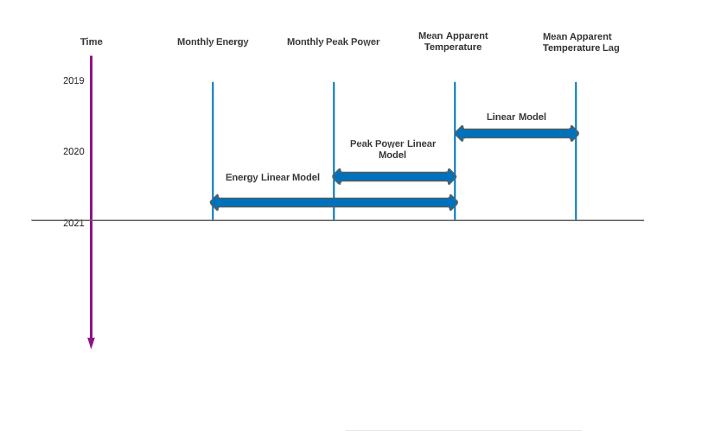

Slide 21
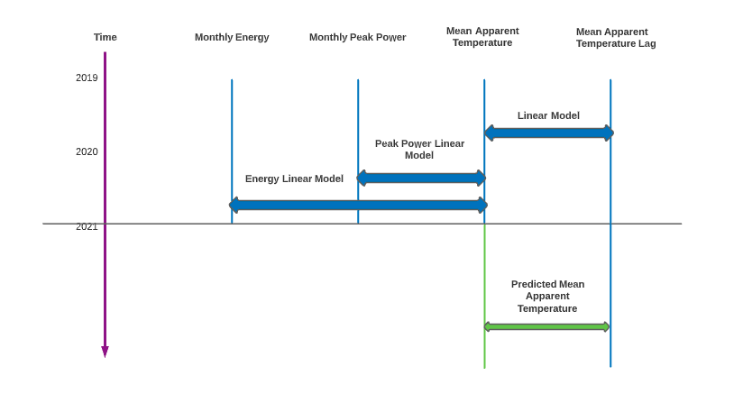

Slide 22
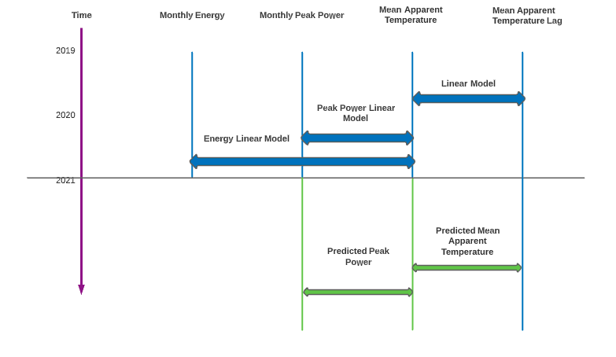

Slide 23
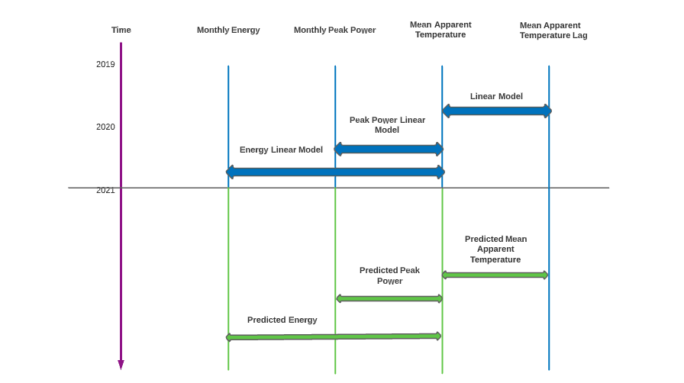

Slide 24
Linear Regression Equation (Energy)
Y: Dependent Variable (Energy)
B0: Intercept
B1: Gradient
X: Independent Variable (Mean Apparent Temperature)
For every 1 degree Celsius increase in Mean Apparent Temperature, the Energy increases by 289197 MWh on average.

Slide 25
Linear Regression Equation (Peak Power)
Y: Dependent Variable (Peak Power)
B0: Intercept
B1: Gradient
X: Independent Variable (Mean Apparent Temperature)
For every 1 degree Celsius increase in Mean Apparent Temperature, the Peak Power increases by 397.22 MW on average.

Slide 26
Results
Results on test data for 2021 year are shown below:
Monthly Energy Forecast:
MAPE: 13.9 %
Monthly Peak Power
MAPE: 11.2 %

Slide 27
Future Work
Dashboard for visualization.
Use five different techniques for forecasting and compare their results.
Forecasting for 10 Distribution Companies (DISCOs) operating in Pakistan.

